Slide 1
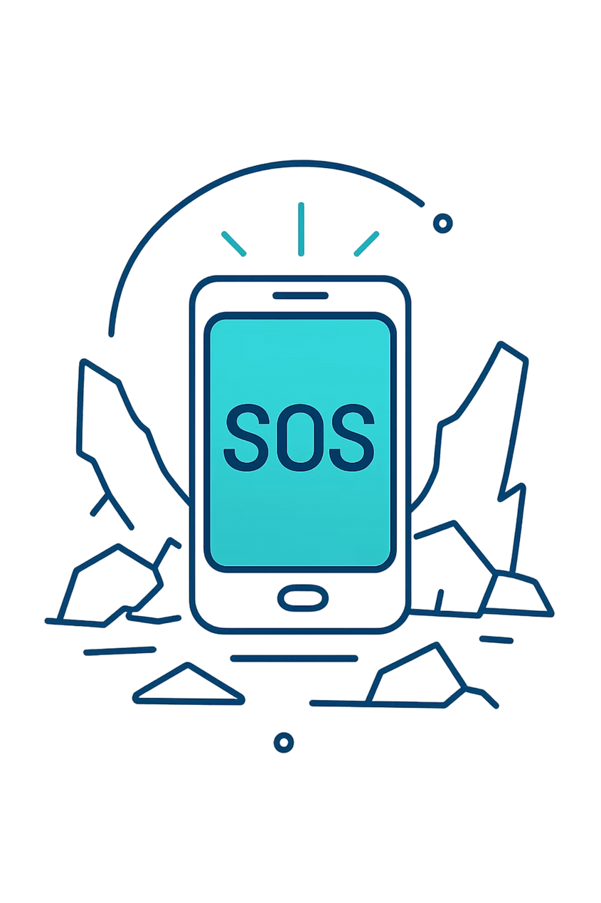
Lifeline
Offline Peer-to-Peer Emergency SOS
A Decentralized Mesh Network for Disaster Scenarios
PROJECT PRESENTATION
Team Members:
Prateek Mishra LCB2023031
Eshant Gupta LCB2023016
Prashik Humane LCB2023039
Mayank LIT2023008
Arun Kumar Swami LCB2023049
Guided By: Dr. Sushil Tiwari Sir
Notes:
1

Slide 2
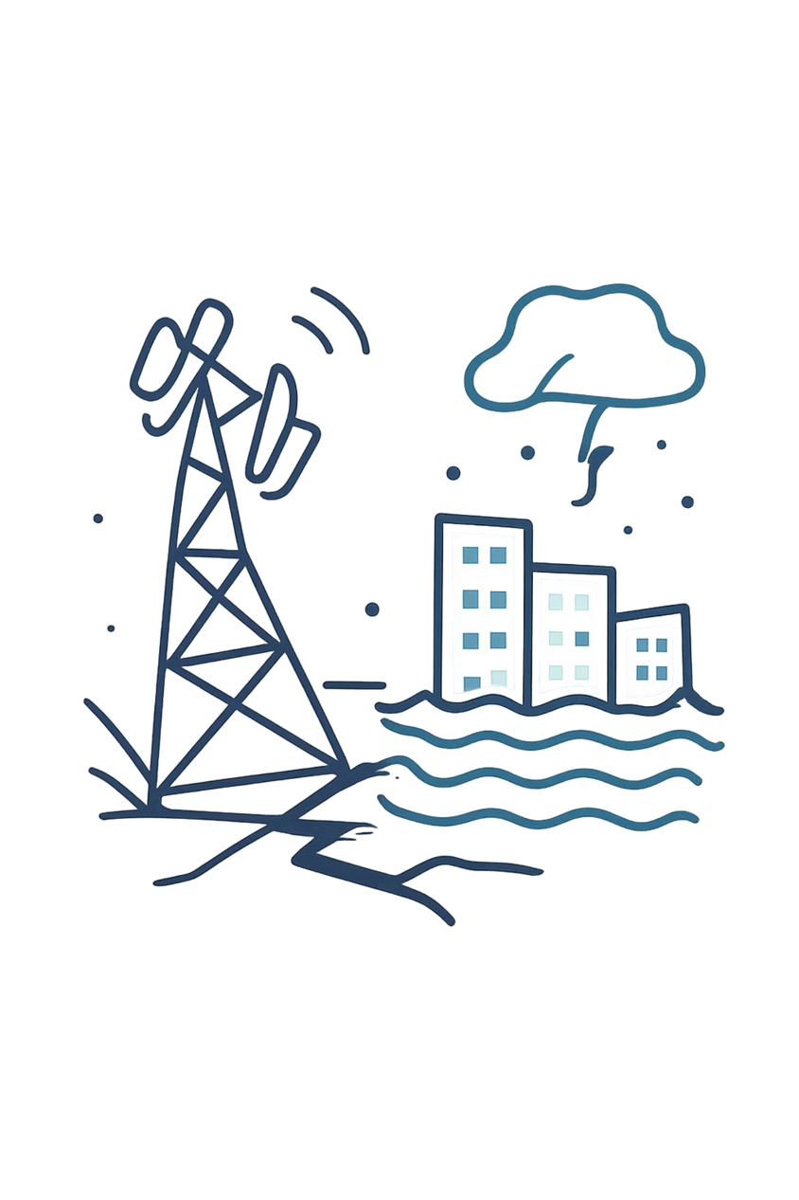

The Problem
Vulnerable Infrastructure
Traditional communication relies heavily on centralized infrastructure — cell towers and ISPs — that can be easily disrupted.
The Blackout Scenario
During earthquakes, floods, or targeted blackouts, this infrastructure collapses entirely, cutting off all communication.
Ineffective Existing Solutions
Standard SOS apps fail entirely without an active SIM card, cellular network, or Wi-Fi internet connection.
The Result
Victims are left isolated, and rescue teams lack coordinated data to locate them efficiently.
Notes:
2

Slide 3
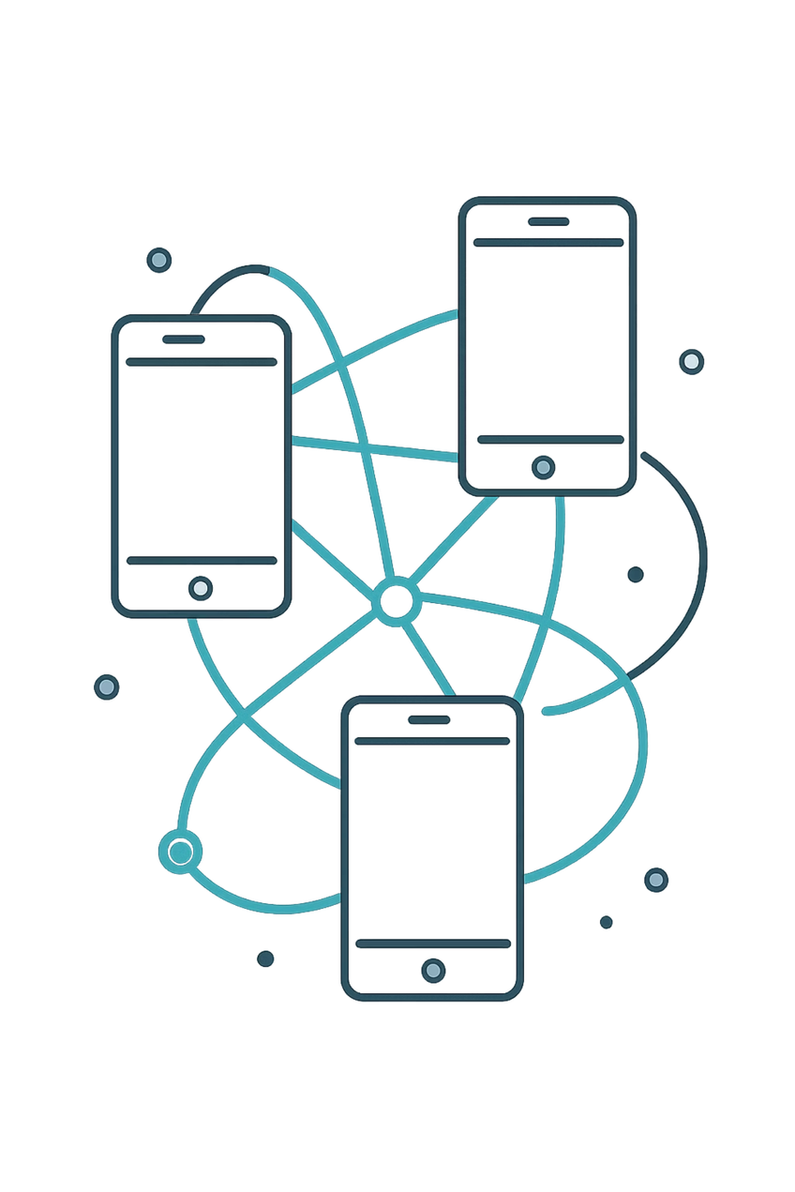




Our Solution: Lifeline
100% Offline Communication
Functions entirely without cellular networks or the internet.
Decentralized Mesh Networking
Connects devices directly using Bluetooth Low Energy (BLE) and Wi-Fi Direct.
Multi-Hop Relay System
SOS signals "hop" from phone to phone, expanding the rescue radius infinitely.
Core Concept
Every smartphone becomes a temporary cell tower/relay node.
Notes:
3

Slide 4


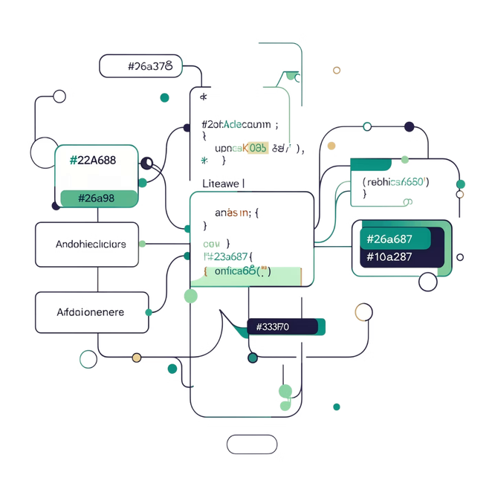




System Architecture & Tech Stack
Language
Kotlin (MVVM Architecture)
Core Networking
Google Nearby Connections API (P2P_CLUSTER strategy)
Local Persistence
Android Room Database (SQLite)
Mapping
osmdroid (Cached Offline Maps)
Cloud Fallback
Firebase Firestore & WorkManager
Notes:
4

Slide 5
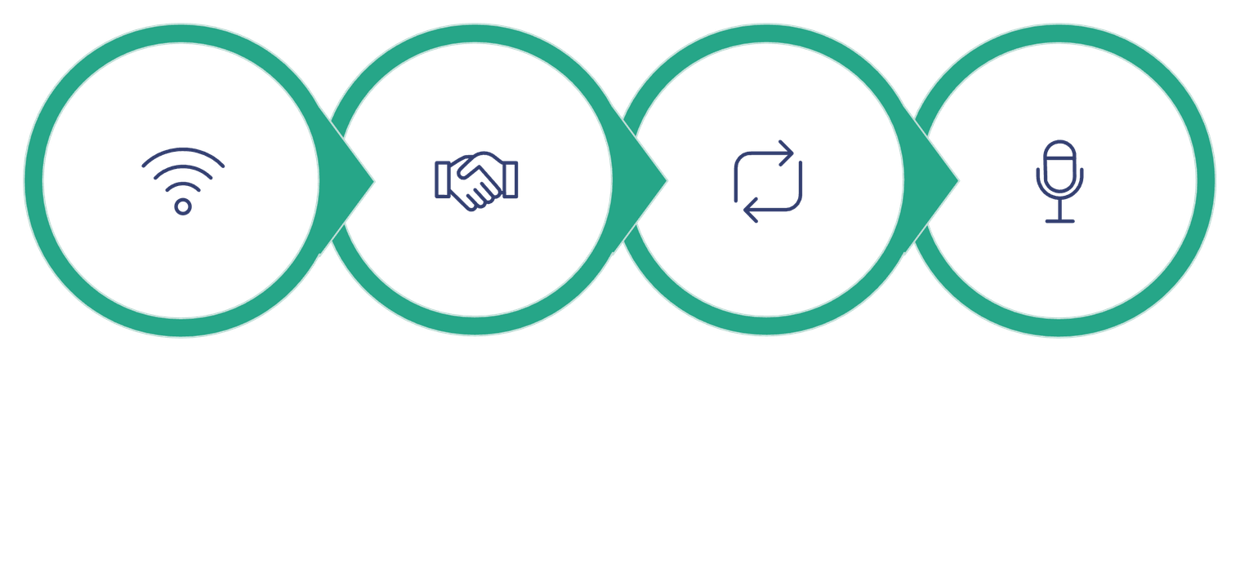
How the Mesh Network Operates
Auto-Accept
Advertise
Relay
Audio
The mesh operates through four key stages: devices simultaneously advertise and discover nearby peers, automatically accept connections in emergency mode, relay new SOS payloads to all connected peers, and support short voice recordings via byte-array transmission.
Notes:
5

Slide 6
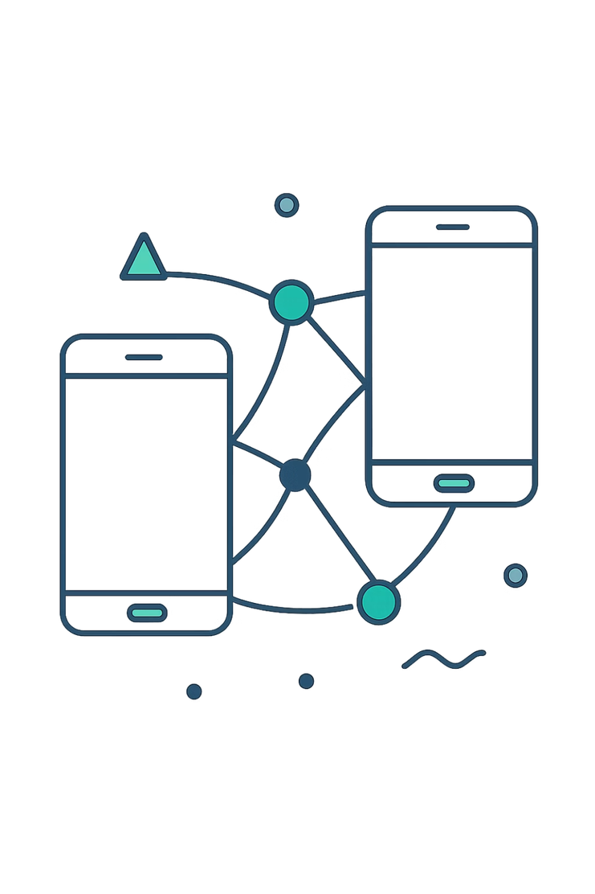
Real-Time Mesh Synchronization
Live Demonstration
The interface running side-by-side on two separate devices.
Peer Connection
Top right indicator shows 1 peer connected, confirming the offline mesh.
Context-Aware UI
The interface dynamically shifts between SAFE and TRAPPED based on user status.
Synchronized Feeds
Both devices display identical distress signals without internet.
Notes:
6

Slide 7
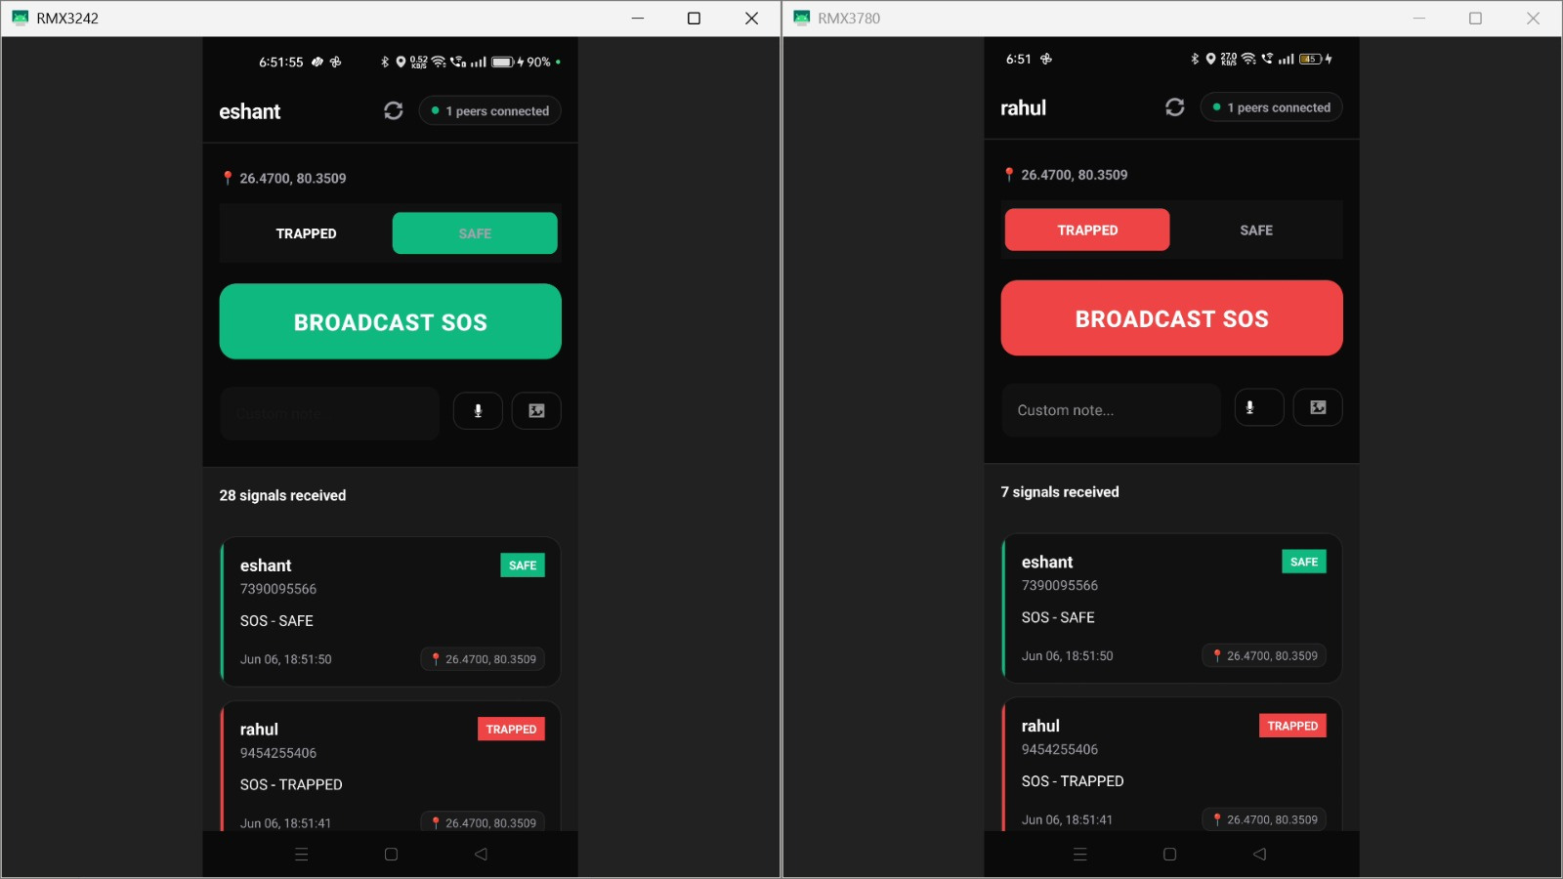
Notes:
7

Slide 8
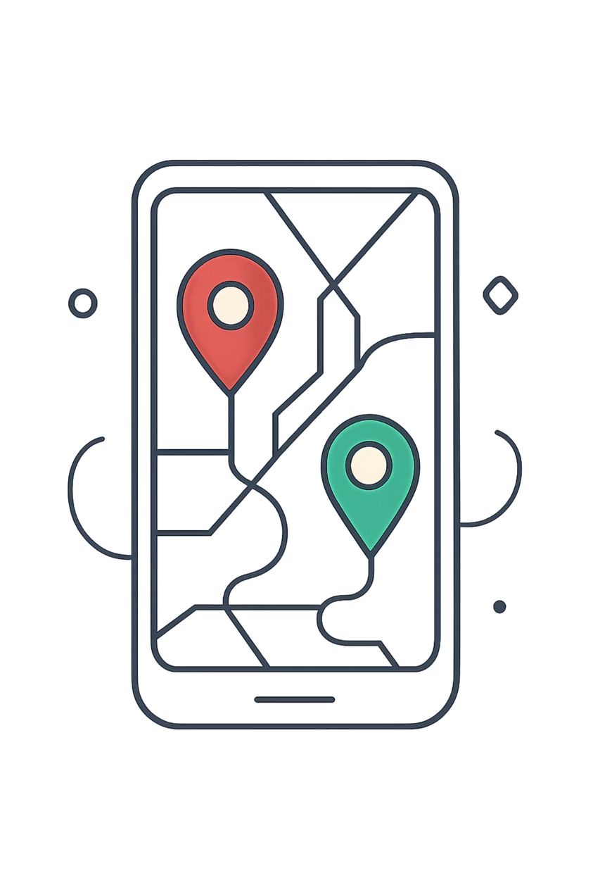
Spatial Awareness: Offline Mapping
Crucial Need
Rescuers need visual context, not just raw GPS coordinates.
Implementation (osmdroid)
Uses locally cached map tiles to render environments without API calls.
Location Integration
Embeds latitude and longitude via Google Play Services Location API directly into the SOS packet.
Visual Indicators
Color-coded markers — Red = Trapped/Danger, Green = Safe/Assisting — rendered on the offline map.
Notes:
8

Slide 9

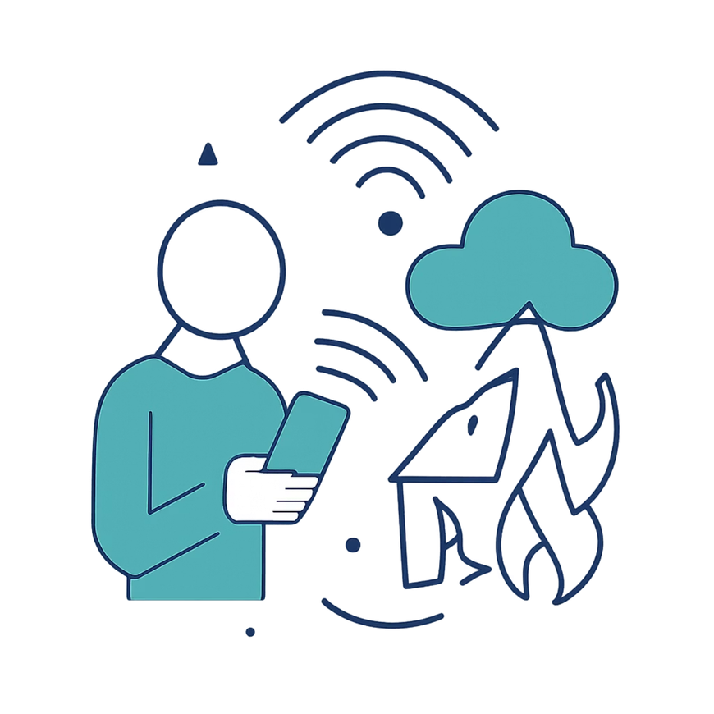
The Bridge to Authorities: Cloud Sync
01
Someone Leaves the Zone
A user with the app exits the disaster area and connects to Wi-Fi or cellular.
02
SyncWorker.kt Detects Connection
Background worker via WorkManager automatically detects the active network.
03
Firebase Integration
Automatically and silently uploads all cached SOS records to Firebase Firestore.
04
Impact on Authorities
Provides remote authorities (NDRF, FEMA, etc.) a sudden, comprehensive view of the disaster area's status.
Notes:
9

Slide 10


Current Limitations & Future Scope
⚠️ Current Limitations
Hardware Dependency
Battery Consumption
Reliability depends heavily on the physical quality of the device's Bluetooth/Wi-Fi radios.
Continuous advertising and discovery drain the battery faster.
🔭 Future Scope
Duty-Cycling Algorithms
Cross-Platform Support
Implement smart sleep/wake cycles to drastically preserve battery life.
Develop an iOS counterpart using Apple's Multipeer Connectivity to increase mesh network density.
Notes:
10

Slide 11
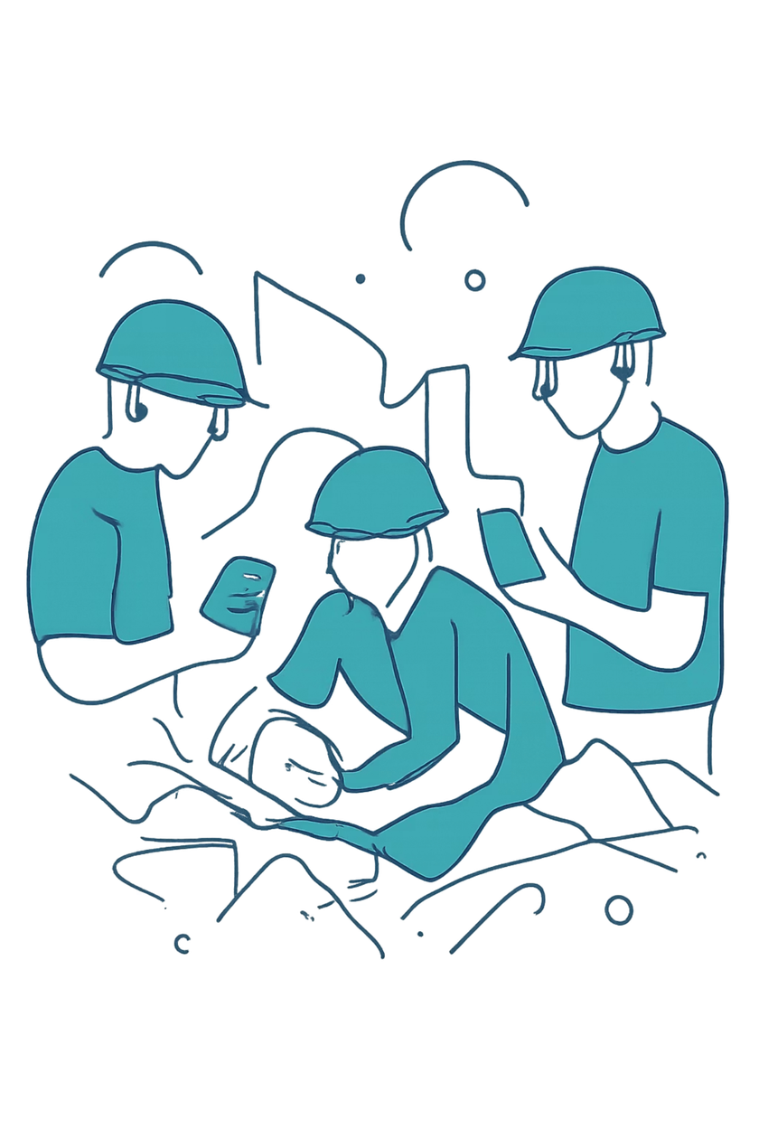
Conclusion
✅ Proven Viability
🔄 Paradigm Shift
Shifts the paradigm from reliance on fragile centralized infrastructure to resilient, decentralized peer-to-peer networks.
Lifeline successfully demonstrates that off-grid communication is viable using standard consumer hardware.
⏱️ Golden Hours
Proves to be a crucial tool for saving lives during the critical 'golden hours' following a disaster.
Notes:
11

Slide 12

Thank You
We appreciate your time and attention. Lifeline represents our commitment to building technology that serves humanity in its most vulnerable moments.
Lifeline
Decentralized
Offline Peer-to-Peer Emergency SOS
Mesh Network for Disaster Scenarios
Notes:
12

